Slide 1

Normalization

Slide 2
normalization
Technique when designing databases
Ensures that same data is only in one place
  When updating data, we only update it in one location
With normalization we want to eliminate redundant (repeated) data
When normalizing, larger tables might be separated into smaller ones and tables linked together.

Slide 3
Benefits of normalization
Normalized tables:
Perform faster
Sort data logically and are easy to navigate
Have less storage requirements (as data is only stored once)
Have less insert, update and delete anomalies

Slide 4
Data Anomalies
Three types:
Update Anomaly
Delete Anomaly
Insert Anomaly

Slide 5
Data Anomalies
Update | Delete | Insert
Occurs when same data is spread into multiple tables
Example:
  You have tables users, gameReviews, Orders
  You store username in each table
  To change user’s username, you need to update all records in each table.
  If you forget to update username in one table, update anomaly will occur

Slide 6
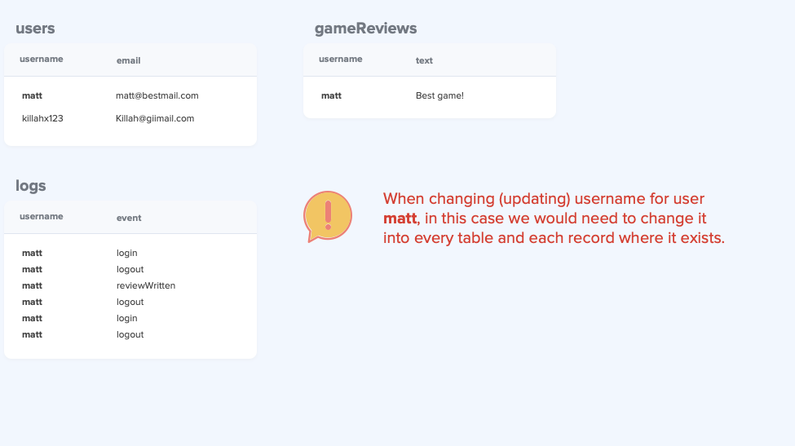
Notes:
Ask: How can we fix this issue?

Slide 7
Data Anomalies
Update | Delete | Insert
Occurs when certain attributes are lost when other attributes are deleted
If you store multiple entities in a single table, this can easily happen

Slide 8
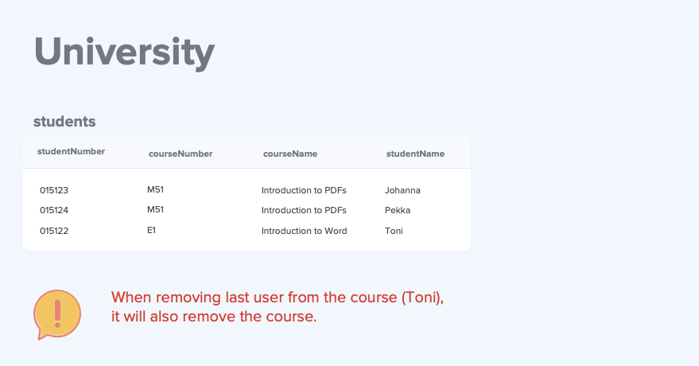
Notes:
- Ask: How can we fix this issue?

Slide 9
Data Anomalies
Update | Delete | Insert
This occurs when our data requires presence of other data to be inserted into the database

Slide 10
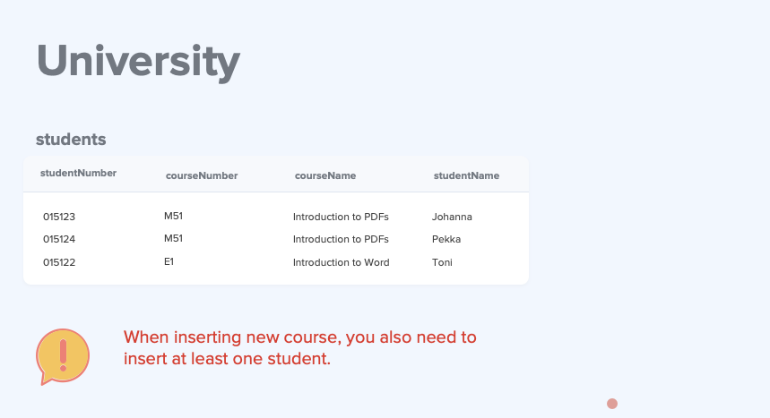
Notes:
- Ask: How can we fix this issue?

Slide 11
Three stages of normalization
1st Normal Form (1NF)
2nd Normal Form (2NF)
3rd Normal Form (3NF)
  3rd normal form is high enough for most databases
  There are also more advanced normalization levels, but not covered during these basic lessons (3.5NF, 4, 5)

Slide 12
Three stages of normalization
1St | 2nd | 3rd
Table is in 1st normal form if:
Each field contains only single value
Values stored in a column must be of same type
There should never be duplicate records
The order of the data does not matter

Slide 13
1st normal form
1 / 4: Each field contains only single value
NO
YES
studentId | subjects
1 | Math, Art
2 | History
studentId | subject
1 | Math
1 | Art
2 | History

Slide 14
1st normal form
1 / 4: Each field contains only single value
ALSO NO
YES
studentId | subject1 | subject2
1 | Math | Art
2 | History
studentId | subject
1 | Math
1 | Art
2 | History

Slide 15
1st normal form
2 / 4: Values stored in a column must be of same type
NO
YES
studentId | subject
1 | Math
2 | Basics of Unix
3 | Sports
studentId | subject
1 | Math
2 | History
3 | Sports

Slide 16
1st normal form
3 / 4: There should never be duplicate records
NO
YES
firstname | lastname
Toni | D’rell
Mark | Smith
Toni | D’rell
studentId | firstname | lastname
1 | Toni | D’rell
2 | Mark | Smith
3 | Toni | D’rell

Slide 17
1st normal form
4 / 4: The order of the data does not matter
studentId | name | name
1 | Toni | Marko
2 | Mark | Smith
3 | Anna | Meikäläinen
studentId | firstname | lastname
3 | Toni | Marko
150 | Mark | Smith
8 | Anna | Meikäläinen

Slide 18
Three stages of normalization
1St | 2nd | 3rd
Table is in 2nd normal form if:
Table is in 1st normal form
Each table should contain information only about a single entity (no partial dependencies)

Slide 19
2nd normal form
2 / 3: Each table should contain information only about a single entity (no partial dependencies)
NO
Courses
courseId | studentName | courseName | courseDescription
1 | Kate Kinsley | C++ | C++ is cool
2 | Tony Thinker | Basics of Tables | Tables are nice
3 | Mark Smith | Introduction to AI | AI is fast
4 | Kate Kinsley | Basics of Tables | Tables are nice

Slide 20
2nd normal form
2 / 3: Each table should contain information only about a single entity (no partial dependencies)
YES
Courses
Students
StudentCourses
courseId | name | description
1 | C++ | C++ is cool
2 | Basics of Tables | Tables are nice
3 | Introduction to AI | AI is fast
4 | Basics of Tables | Tables are nice
studentId | name
1 | Kate Kinsley
2 | Tony Thinker
3 | Mark Smith
studentId | courseId
1 | 1
2 | 2
3 | 3
1 | 4

Slide 21
Three stages of normalization
1St | 2nd | 3rd
Table is in 3rd normal form if:
Table is in 2nd normal form
There is no other non key attribute that needs to be changed when changing another non key attribute (no transitive dependencies)

Slide 22
3rd normal form
2 / 2: There should be no other non key attribute that needs to be changed when changing another non key attribute (no transitive dependencies)
Courses
NO
courseId | courseName | courseDescription | courseTeacherName | courseTeacherAge
1 | C++ | C++ is cool | Tina Teacher | 35
2 | Basics of Tables | Tables are nice | Tim Tutor | 52
3 | Introduction to AI | AI is fast | Mark Powerpoint | 48
4 | Basics of Tables | Tables are nice | Mark Powerpoint | 48

Slide 23
3rd normal form
2 / 2: There should be no other non key attribute that needs to be changed when changing another non key attribute (no transitive dependencies)
Courses
YES
Teachers
CourseTeachers
courseId | name | courseDescription
1 | C++ | C++ is cool
2 | Basics of Tables | Tables are nice
3 | Introduction to AI | AI is fast
4 | Basics of Tables | Tables are nice
teacherId | name | age
1 | Tina Teacher | 35
2 | Tim Tutor | 52
3 | Mark Powerpoint | 48
teacherId | courseId
1 | 1
2 | 2
3 | 3
3 | 2

Slide 24
Note on normalization
We might skip normalizing some data
For example
  Address could be split into their own tables called addressZipCodes, addressPhone, addressCountry, addressStreet etc... BUT creating all these tables would make your database cumbersome to use
  Generally in this case it is better to just have a table like customerAddresses

Slide 25
Good
YES
Teachers
TeacherAddresses
teacherId | teacherName
1 | Tina Teacher
2 | Tim Tutor
3 | Mark Powerpoint
2 | Tim Tutor
teacherId | street | zipcode | phone
1 | London Street 12 | 51232 | 1234567
2 | Tampere Street 2 | 51223 | 5123233
3 | Long Bridge 13 | 61243 | 6342342
4 | Apartment 1 B 2 | 51244 | 6512423

Slide 26
TOO MUCH
NO
Teachers
TeacherAddresses
teacherId | teacherName
1 | Tina Teacher
2 | Tim Tutor
3 | Mark Powerpoint
2 | Tim Tutor
teacherId | streetId | zipcodeId | phoneId
1 | 5 | 1 | 1
2 | 3 | 4 | 6
3 | 4 | 5 | 3
2 | 6 | 7 | 2
.. And you would have tables TeacherStreetAddresses, TeacherStreetIds, TeacherZipCodes, TeacherPhones

